Slide 1
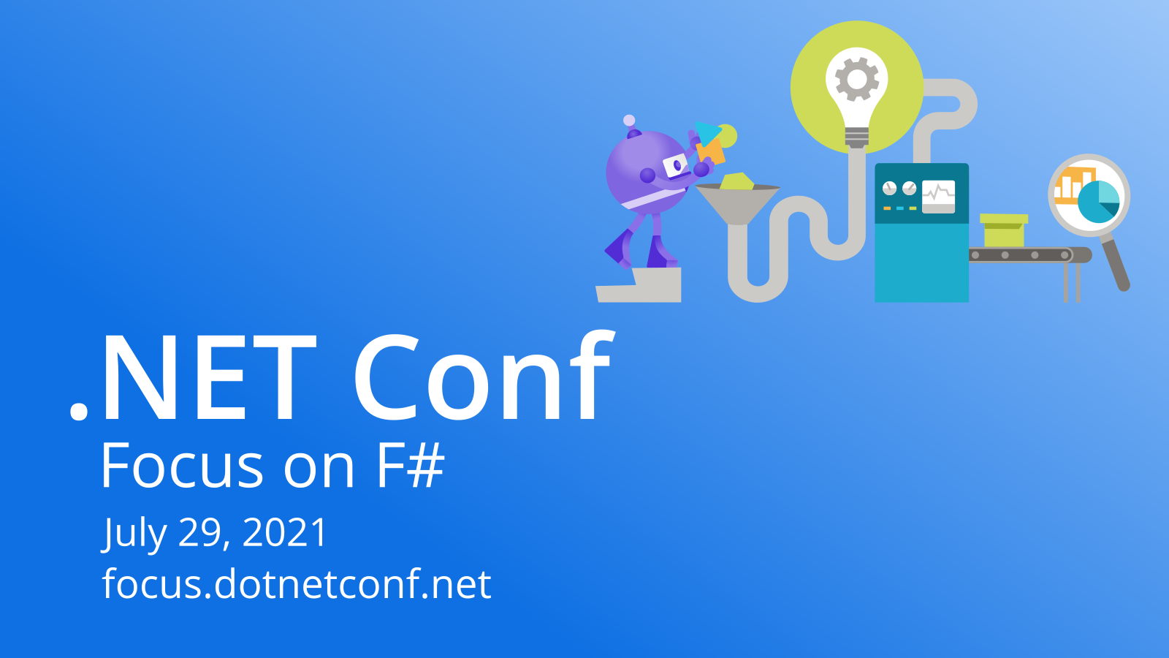

Slide 2


Don teaches Guido some F#
Don Syme & Guido van Rossum

Slide 3
https://github.com/dsyme/guido-learns-fsharp

Slide 4
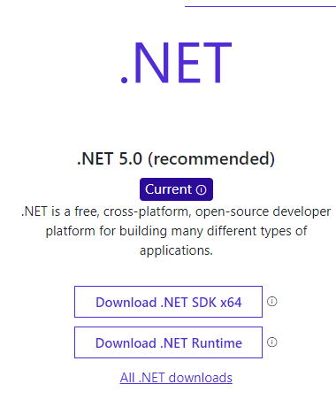
Setup
.NET SDK https://dotnet.microsoft.com/download

Slide 5
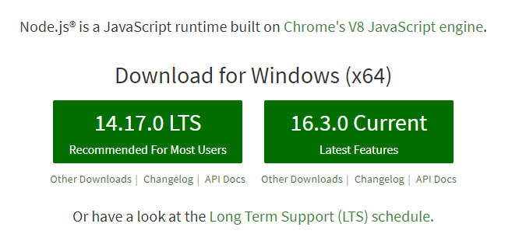
Setup
Node.js and npm https://nodejs.org/en/

Slide 6
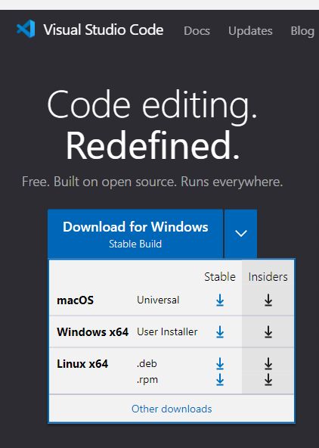
Setup
VS Code https://code.visualstudio.com/
On Linux, don’t use Snap

Slide 7
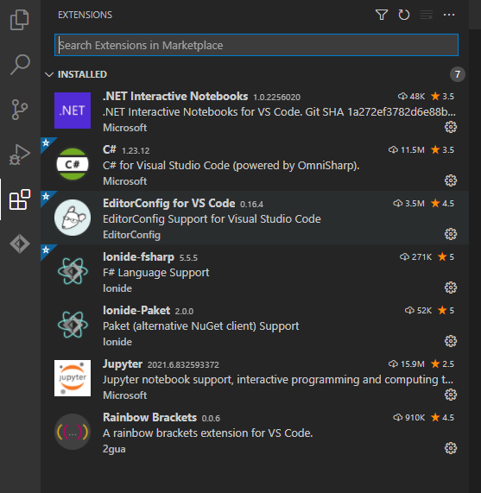
Setup - VS Code Extensions
Ionide

Slide 8
Now do Tasks 1.*

Slide 9
Language Lessons from Tasks 1.*
You've learned or seen all of the following:
let let let let (function definitions and values)
match for pattern matching and strings
dot notation. F# supports object programming
strings, including interpolated strings
F# is strongly typed. The IDE knew your types and checks on the fly
F# knows how symbols resolve: rename, goto-definition etc.

Slide 10
F# achieves three key things
Succinctness (like Python)
Performance (like C#/Java)
Robustness (like strongly typed functional programming)
(also interop, support, cross-platform, community, reach etc. )

Slide 11
This is a typical Client/Server App
REST API
Server
Web Client
F#
F#
.NET
JavaScript

Slide 12
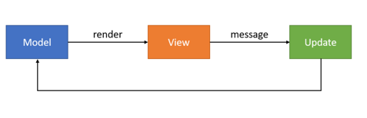
The Web Client uses “Model View Update” c.f. React
REST API
Web Client
view
dispatch
update

Slide 13
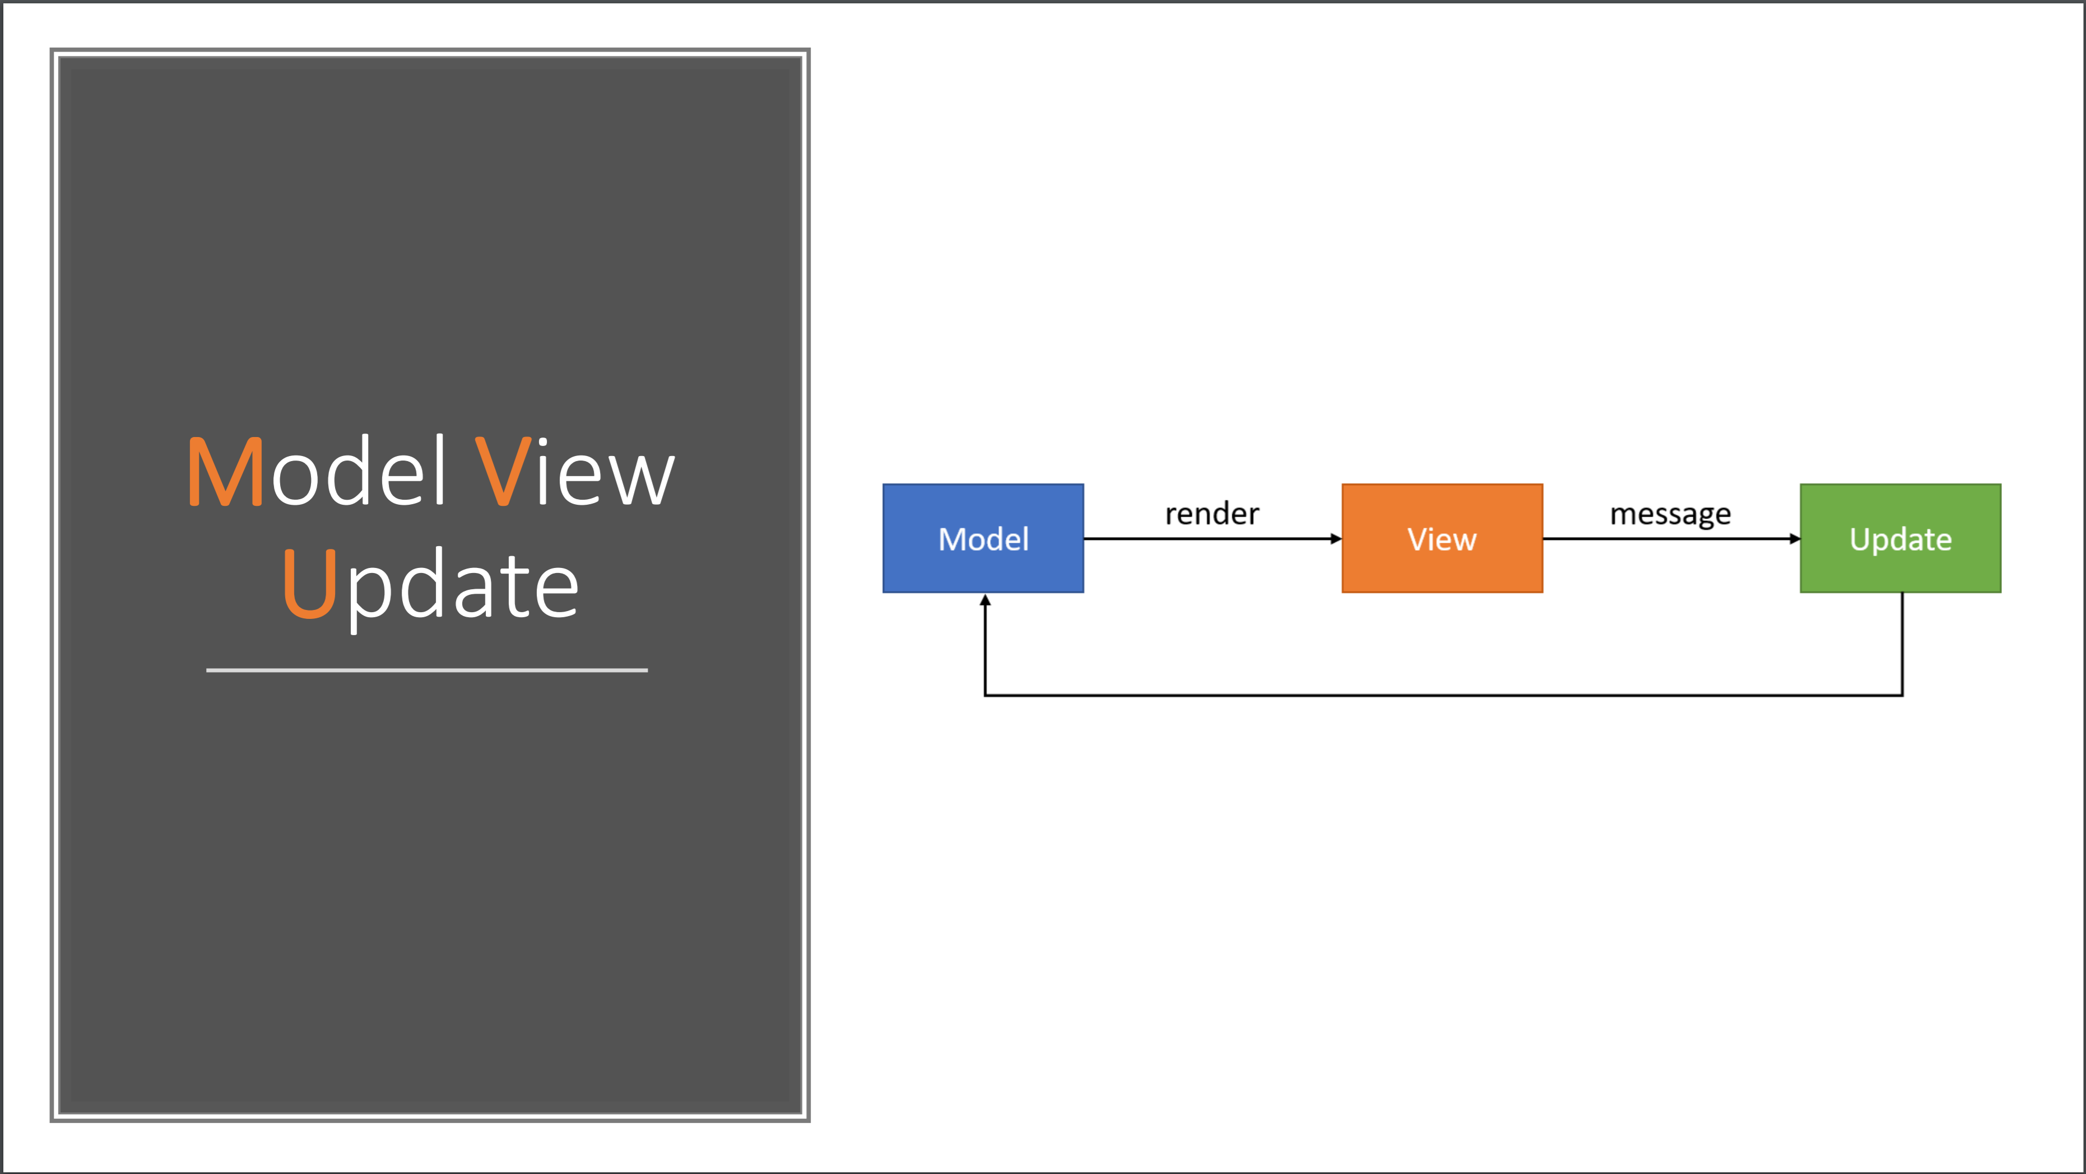

Slide 14
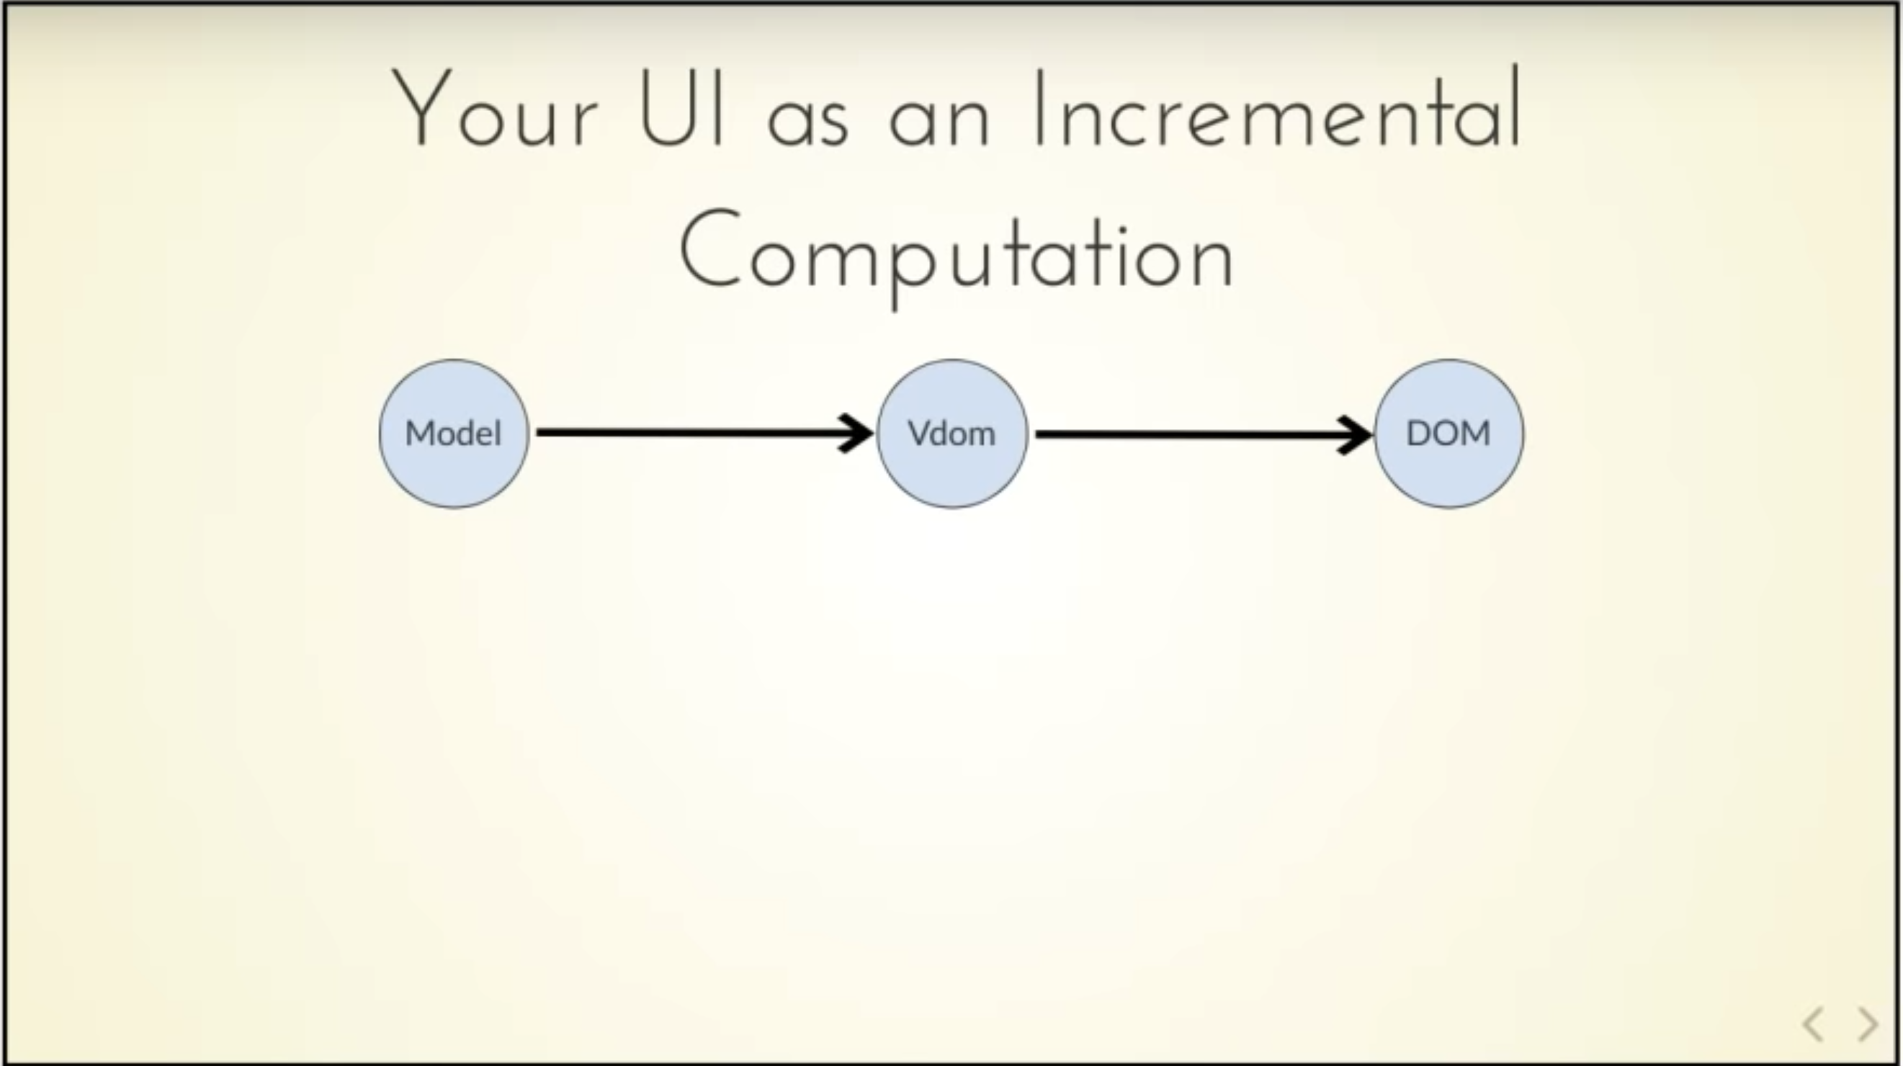
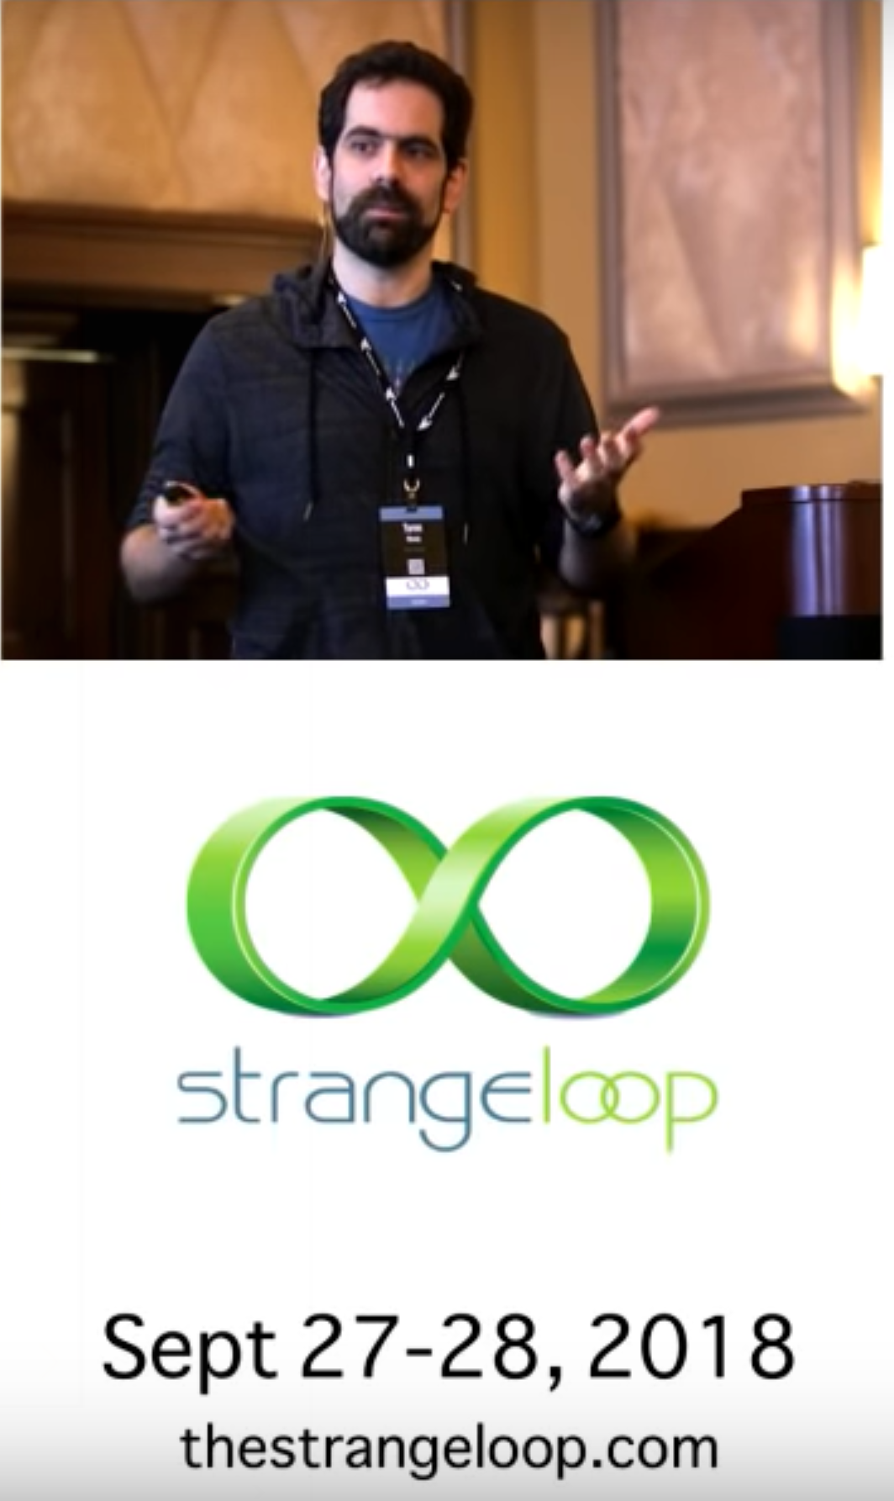
view

Slide 15
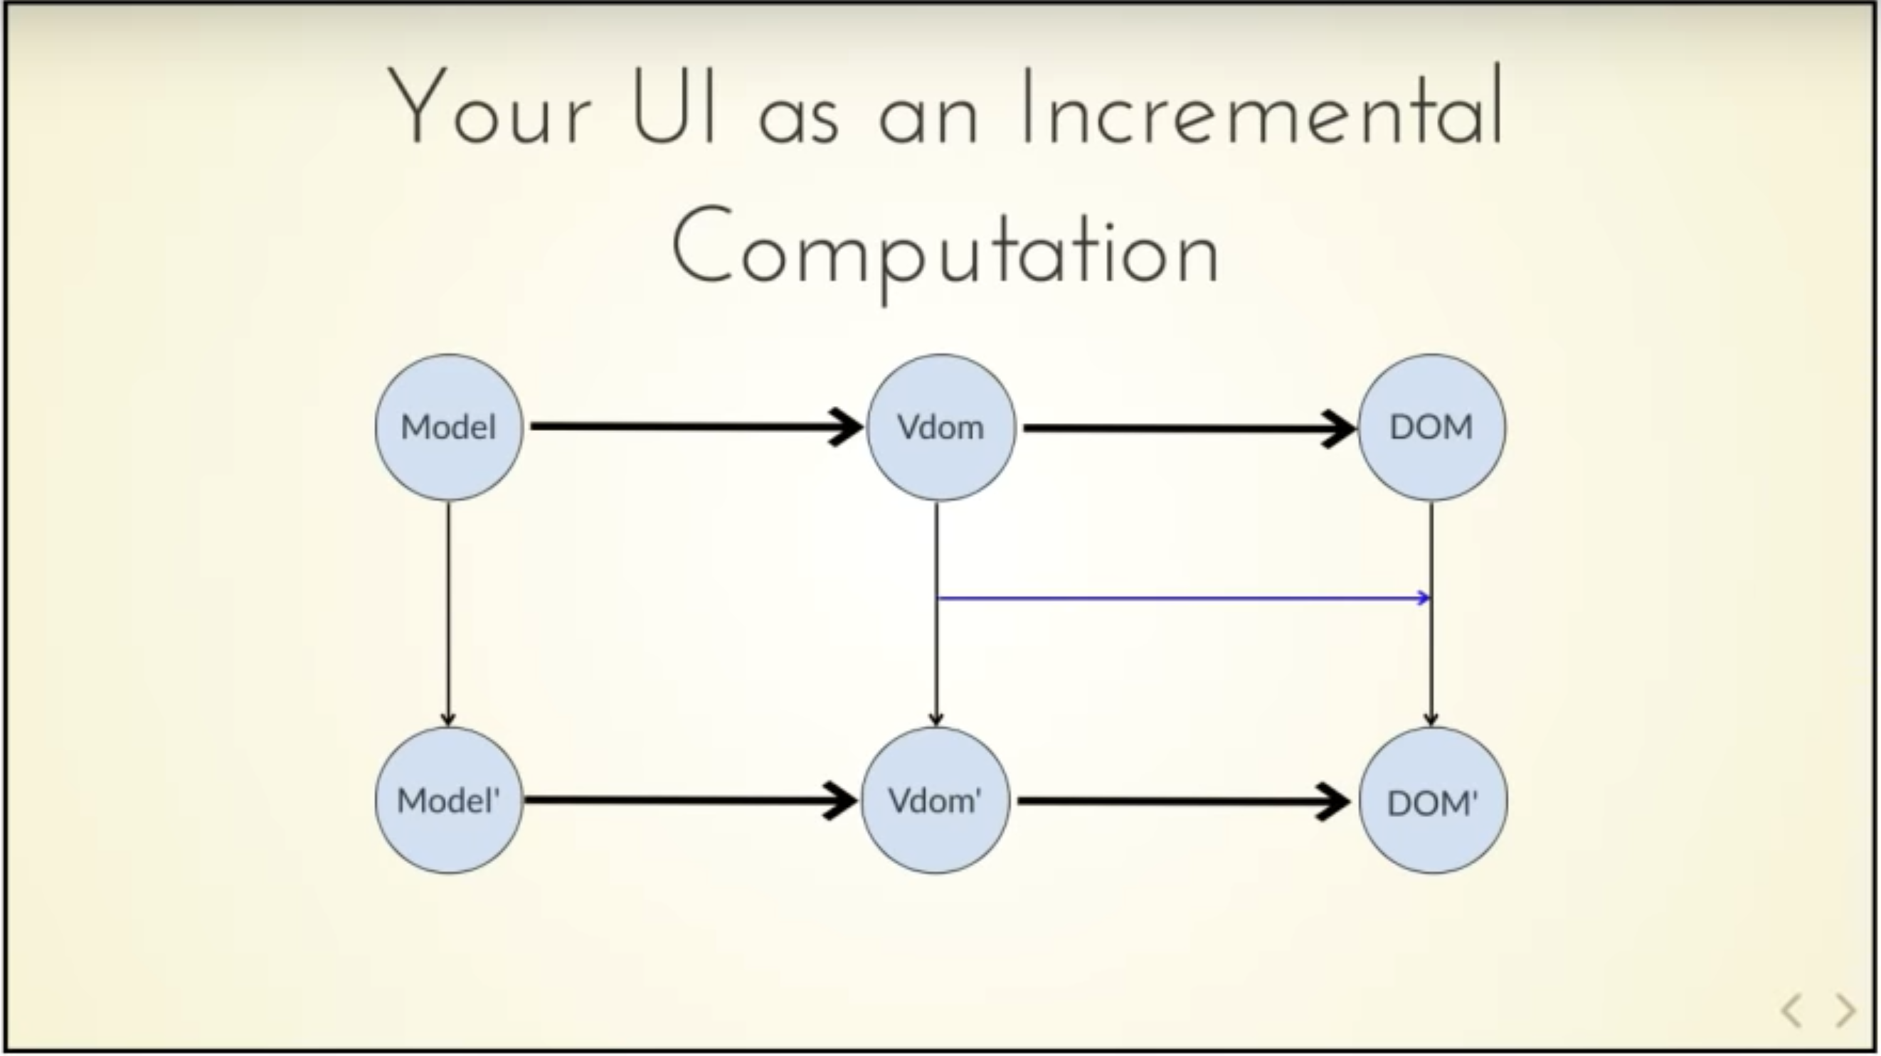
Δ
view
update
Δ
view

Slide 16
Now do Tasks 2.*

Slide 17
Lessons from Tasks 2.*
You've learned or seen all of the following:
In this app, display views are functional data
The view is recalculated and applied to the actual DOM
The functional view uses computed list expressions, a super-powerful form of list comprehensions
tuples and helper functions

Slide 18
Now do Tasks 3.*

Slide 19
Lessons from Tasks 3.*
You've learned or seen all of the following:
“let” and “type” all day long
pipelining with |>
record types - cheap and cheerful functional data
async programming for server requests
strongly typed string interpolation

Slide 20
Now do Tasks 4.*

Slide 21
Lessons from Tasks 4.*
You've learned or seen all of the following:
discriminated union types for messages in a web UI
pattern matching and completeness checks
functional objects with method/property members
dispatching a new message in this UI architecture

Slide 22
Now do Tasks 5.*

Slide 23
Lessons from Tasks 5.*
You've learned or seen all of the following:
evaluating code in the F# REPL
referencing a package with a strong version
using FSharp.Data with a sample from a REST API
exploring the data in preparation for adding a backend service

Slide 24
Further discussion points! ☺

Slide 25
Other F# Language Discussion Points
let mutable
box/unbox
reflection
performance
namespace and modules for code organization
F# is not lazy by default (see ‘lazy’ expressions)
Bi-directional .NET and Javascript interop
Fable now includes an F# to Python transpiler. If Python gives us metadata, we will interop smoothly with Python

Slide 26
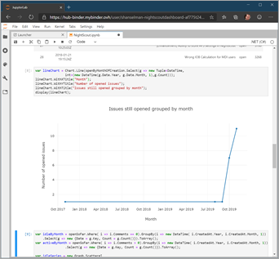
F# in .NET Interactive/Jupyter Notebooks

Slide 27
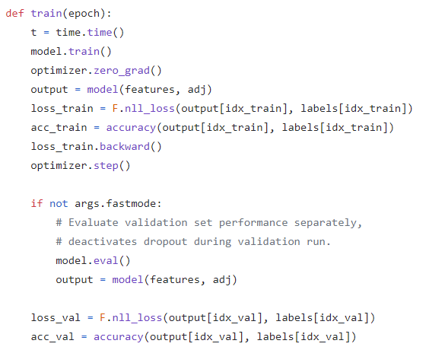
Python GCN

Slide 28
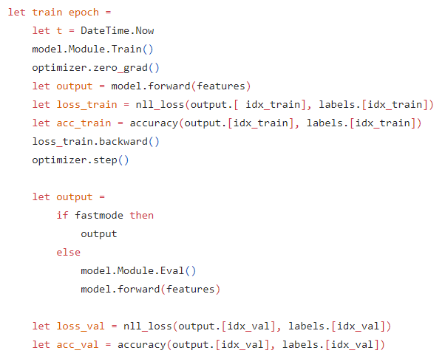
F# GCN
https://www.linkedin.com/pulse/graph-convolutional-network-model-strongly-typed-faisal-waris-phd/

Slide 29
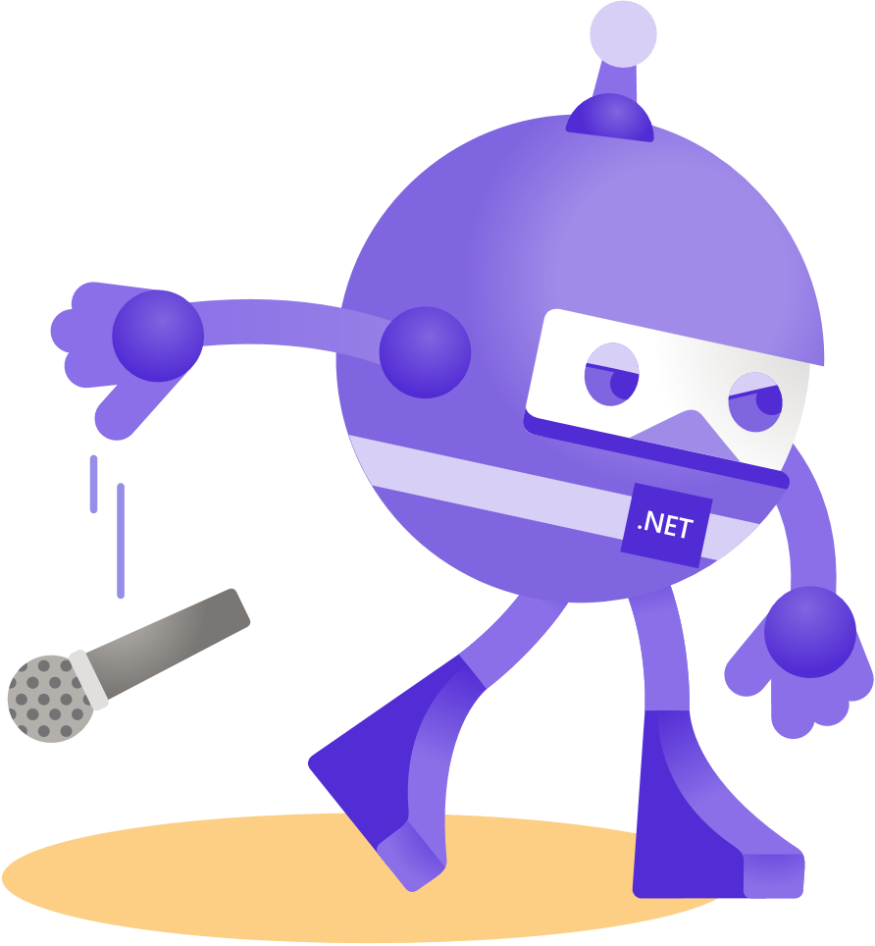
Thank you Guido!
Ask your questions live on Twitter #dotNETConf

Slide 30
Thanks for joining!
Ask your questions live on Twitter #dotNETConf

Slide 31
Other slides

Slide 32
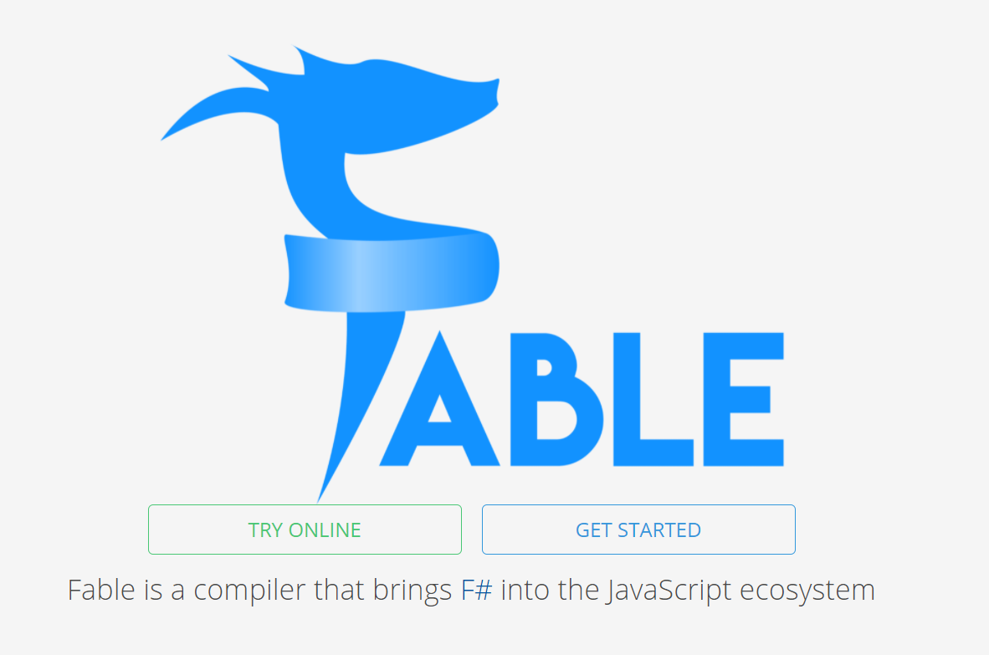

Slide 33
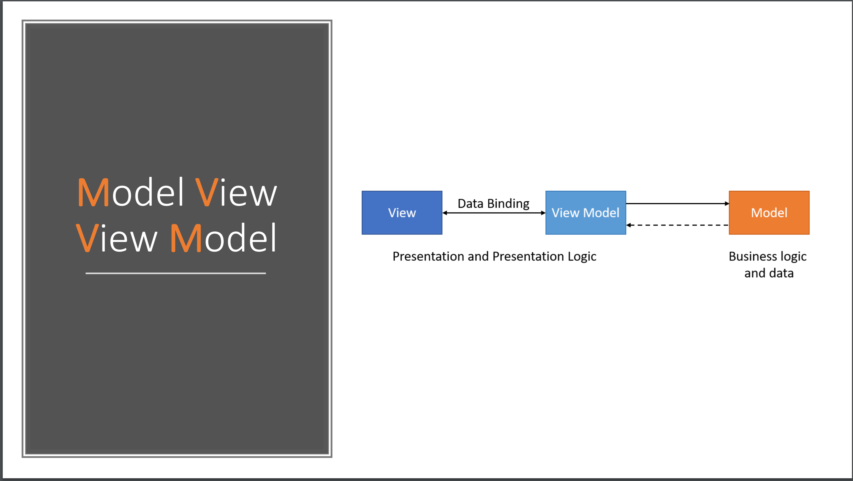

Slide 34
❌

Slide 35
MVU
Calculate your views with functional programming

Slide 36
A Simple MVU App
type Model =
{ … }
type Msg =
| …
| …
let init() =
{ … }
let update msg model =
match msg with
| … -> { model with … }
| … -> { model with … }
let view model dispatch =
if model.IsPressed then
… dispatch msg …
else
… dispatch msg …
The model from which
the view is generated
Messages which cause
updates to the model
Initial state
Update the model
Compute the view

Slide 37
A Simple MVU App
type Model =
{ IsPressed: bool }
type Msg =
| Pressed
let init() =
{ IsPressed=false }
let update (msg: Msg) (model: Model) =
match msg with
| Pressed -> { model with IsPressed = true }
let view (model: Model) dispatch =
if model.IsPressed then
View.Label(text="I was pressed!")
else
View.Button(text="Press Me!", command=(fun () -> dispatch Pressed))
The model from which
the view is generated
Messages which cause
updates to the model
Initial state
Update the model
Compute the view

Slide 38






F# get started
dotnet new -lang F# dotnet build
F# tools are part of the .NET SDK, available everywhere

Slide 39

F# for the backend
dotnet new -i "giraffe-template::*" dotnet giraffe
A functional ASP.NET Core micro web framework for building rich web applications.
High perf, functional server-side programming
github.com/giraffe-fsharp/Giraffe

Slide 40

F# for the frontend (JS)
dotnet new -i "Fable.Template::*" dotnet new fable npm install npm start
You can use F# as a JavaScript language
NOTE: See also WebSharper

